Slide 1

Chapter 6
Intermediate Code Generation
Unit 3 (contd..)

Slide 2
Outline
Variants of Syntax Trees
Three-address code
Types and declarations
Translation of expressions
Control flow
Backpatching

Slide 3
Introduction
Intermediate code is the interface between front end and back end in a compiler
Ideally the details of source language are confined to the front end and the details of target machines to the back end (a m*n model)
We study intermediate representations, static type checking and intermediate code generation
Parser
Static
Checker
Intermediate Code Generator
Code Generator
Front end
Back end

Slide 4
Variants of syntax trees
It is sometimes beneficial to crate a DAG instead of tree for Expressions.
This way we can easily show the common sub-expressions and then use that knowledge during code generation
Example: a+a*(b-c)+(b-c)*d
The common subexpression b-c has two parents , a*(b-c) and (b-c)*d
Next a+a*(b-c) is
evaluated
+
+
*
*
d
a
-
b
c

Slide 5
SDD for creating DAG’s
Production
Semantic Rules
E -> E1+T
E -> E1-T
E-> E1*T
E -> T
T -> (E)
T -> id
T -> num
E.node= new Node(‘+’, E1.node,T.node)
E.node= new Node(‘-’, E1.node,T.node)
E.node=new Node(‘*’, E1.node, T.node)
E.node = T.node
T.node = E.node
T.node = new Leaf(id, id.entry)
T.node = new Leaf(num, num.val)
Steps for constructing the DAG:
p1=Leaf(id, entry-a)
p2=Leaf(id, entry-a)=p1
p3=Leaf(id, entry-b)
p4=Leaf(id, entry-c)
p5=Node(‘-’,p3,p4)
p6=Node(‘*’,p1,p5)
p7=Node(‘+’,p1,p6)
Note: When call is repeated, node p2=p1
p8=Leaf(id,entry-b)=p3
p9=Leaf(id,entry-c)=p4
p10=Node(‘-’,p3,p4)=p5
p11=Leaf(id,entry-d)
p12=Node(‘*’,p5,p11)
p13=Node(‘+’,p7,p12)

Slide 6
Value-number method for constructing DAGs
Array
DAG for expression i=i+10
=
1
2
3
4
5
id
To entry for i
num
10
+
+
1
2
=
1
3
i
10
Algorithm
  Search the array for a node M with label op, left child l and right child r
  If there is such a node, return the value number M
  If not create in the array a new node N with label op, left child l, and right child r and return its value
  Refer to the nodes by giving integer index of the record for that node within the array. Ex. id for i & num for 10 have index 1&2. for i+10 write 1&2.
We may use a hash table instead.

Slide 7
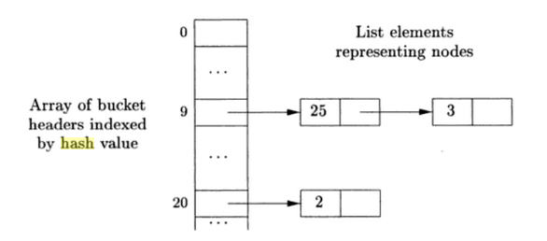
Hash table for the nodes of DAG for array
Hash function h computes the index of the bucket.
Buckets can be implemented as linked lists.
Within the linked list for a bucket each cell holds the value number of one of the nodes that hash into that bucket.
If a match for value number v found in the cell we need to check if matching input signature <op, l, r> can be found.

Slide 8
Three address code
In a three address code there is at most one operator at the right side of an instruction. Expression x*y*z must be translated into i) t1=y*z; ii) t2=x+t1
Example: a+a*(b-c)+(b-c)*d
+
t1 = b – c
t2 = a * t1
t3 = a + t2
t4 = t1 * d
t5 = t3 + t4
+
*
*
d
a
-
b
c

Slide 9
Forms of three address instructions: various types
x = y op z
x = op y
x = y
goto L : unconditional jump
if x goto L and ifFalse x goto L
if x relop y goto L
x = y[i] this sets x to the value in the location i memory units beyond location y
and x[i] = y sets contents of the location i units beyond x to the value of y
Address allocation x = &y and x = *p (content pointed by p is assigned to x
and *x =y (data value equated => r value of the object pointed to by x to the r value of y.
Notes:
L value : location value; R value : data value
#include <stdio.h>
int main() {
int a=10;
int n=1, x=2;
int *p, *s;
int b[10];
p=&a;
n=*p;
b[1]=24;
printf("a=%d &a=%d *b=%d b[1] value=%d, n=%d \n", a, &a, *b, b[1], n);
p=&x;
n=*p;
*p=20;
n=*p; /* reinitialization with contents pointed to by p shows intended value */
printf("n=%d, %d\n", n, p); /* n shows 20 here */
n=10;
p=&n;
s=&x;
printf("p=%d, s=%d, n=%d, x=%d\n", p,s,n,x);
*s=*p; /* equating the R values of n & x, so that x gets n vale of 10 */
printf("n= %d, x=%d", n,x);
n=23;
*s = n; will make both n&s as 23.
}

Slide 10
Forms of three address instructions: procedure call
Procedure calls using:
  param x for parameters
  call p,n for procedure call , where n : #parameters & p is procedure
  y = call p,n for function call , where y is return value
Typical procedure call will be as below:
  param x1
  param x2
  …
  param xn
  call p,n

Slide 11
Examples of translations to three address code
do i = i+1; while (a[i] < v);
L: t1 = i + 1
i = t1
t2 = i * 8
t3 = a[t2]
if t3 < v goto L
100: t1 = i + 1
101: i = t1
102: t2 = i * 8
103: t3 = a[t2]
104: if t3 < v goto 100
Symbolic labels
Position numbers

Slide 12
Data structures for three address codes
Quadruples
  Has four fields: op, arg1, arg2 and result
Triples
  Temporaries are not used and instead references to instructions are made
Indirect triples
  In addition to triples we use a list of pointers to triples

Slide 13
Example
Three address code
a=b * minus c + b * minus c
t1 = minus c
t2 = b * t1
t3 = minus c
t4 = b * t3
t5 = t2 + t4
a = t5
Triples are compact, but quadruples have freedom to move instructions without making changes to temp. variables.
Indirect triples consist of listing of pointers to triples. With this, reordering of instructions for optimization can be done easily.
Quadruples
Triples
Indirect Triples
op
arg1
arg2
result
op
arg1
arg2
Instruction
op
arg1
arg2
minus
c
t1
0
minus
c
35
(0)
0
minus
c
*
b
t1
t2
1
*
b
(0)
36
(1)
1
*
b
(0)
minus
c
t3
2
minus
c
37
(2)
2
minus
c
*
b
t3
t4
3
*
b
(2)
38
(3)
3
*
b
(2)
+
t2
t4
t5
4
+
(1)
(3)
39
(4)
4
+
(1)
(3)
=
t5
a
5
=
a
(4)
40
(5)
5
=
a
(4)

Slide 14
Static single assignment (SSA)
y := 1; y := 2; x := y
SSA form : y₁ := 1 ; y₂ := 2 ; x₁ := y₂
SSA in control flow has φ function to combine 2 definitions of a variable x for the true /false part.
Compiler optimization algorithms which are either enabled or strongly enhanced by the use of SSA include:
  Constant propagation
  Value range propagation^{[3]}
  Sparse conditional constant propagation
  Dead code elimination
  Global value numbering
  Partial redundancy elimination
  Strength reduction
  Register allocation

Slide 15
Translation of Expressions and Statements
Translation into 3 address code; an expression a+b*c will translate into instructions with atmost one operator per instruction.
Array reference will expand into a sequence of 3 address instructions calculating address for the reference.
3 address code for assignment statement S using attribute code for S & attributes addr & code for an expression E

Slide 16
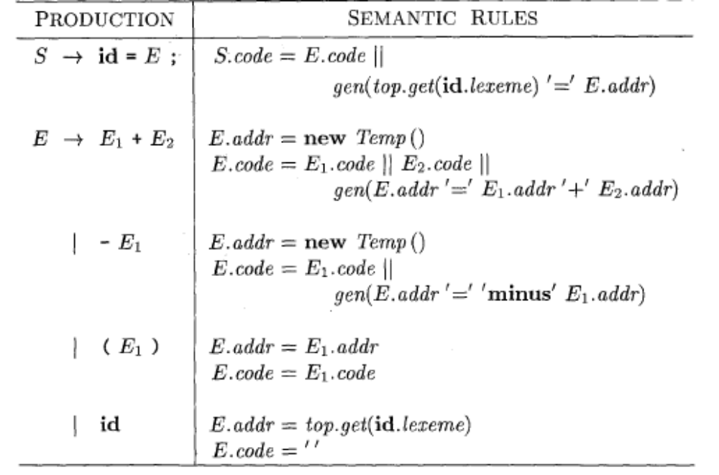
Three-address code for expressions
This translates a=b+-c into 3 address sequence
t1= minus c; t2=b+t1; a=t2

Slide 17
Description
Attributes S.code & E.code denote 3 address code for statement S and expression E, respectively.
Attribute E.addr denotes the address that will hold the value for E.
The last production E->id has value in id. Function top. get retrieves the entry when it is applied to the string representation id.lexeme of this instance of id. E.code is set to the empty string. Top denotes the current symbol table.
When E -> (E1), the translation of E is the same as that of the subexpression E1. Hence, E.addr equals E1.addr, and E.code equals E1.code.
Notes:
Addr attribute can be a name, a constant, or compiler generated temporary.

Slide 18
Translation of expressions (contd..)
The operators + and unary - are representative of the operators in a typical language. The semantic rules for E —> E1 + E2, generate code to compute the value of E from the values of E1 and E2. Values are computed into newly generated temporary names with new Temp()
For convenience, we use the notation gen(x '=' y '+' z) to represent the three-address instruction x = y + z. Expressions appearing in place of variables like x, y, and z are evaluated when passed to gen, and quoted strings like '=' are taken literally.
Other 3 address instructions are built by applying gen to a combination of expressions & strings.

Slide 19
Translation of expressions (contd..)
When we translate the production E -> E1+E2, the semantic rules build up E.code by concatenating E1.code, E2.code, and an instruction that adds the values of E1 and E2. The instruction puts the result of the addition into a new temporary name for E, denoted by E.addr
The translation of E -> - E1 is similar. The rules create a new temporary for E and generate an instruction to perform the unary minus operation.
Finally, the production S-> id = E; generates instructions that assign the value of expression E to the identifier id. The semantic rule for this production uses function top.get to determine the address of the identifier represented by id, as in the rules for E —> id. S.code consists of the instructions to compute the value of E into an address given by E.addr, followed by an assignment to the address top.get(id.lexeme) for this instance of id.

Slide 20
Incremental translation
Code attributes can be long strings, so they are generated incrementally. In incremental method we generate only the new three-address instructions.
Here gen not only constructs a three-address instruction, it appends the instruction to the sequence of instructions generated so far. The sequence may either be retained in memory for further processing, or it may be output incrementally.
With the incremental approach, the code attribute is not used, since there is a single sequence of instructions that is created by successive calls to gen. For example, the semantic rule for E ->E1+ E2 calls gen to generate an add instruction; the instructions to compute E1 into E1.addr and E2 into E2.addr have already been generated.

Slide 21
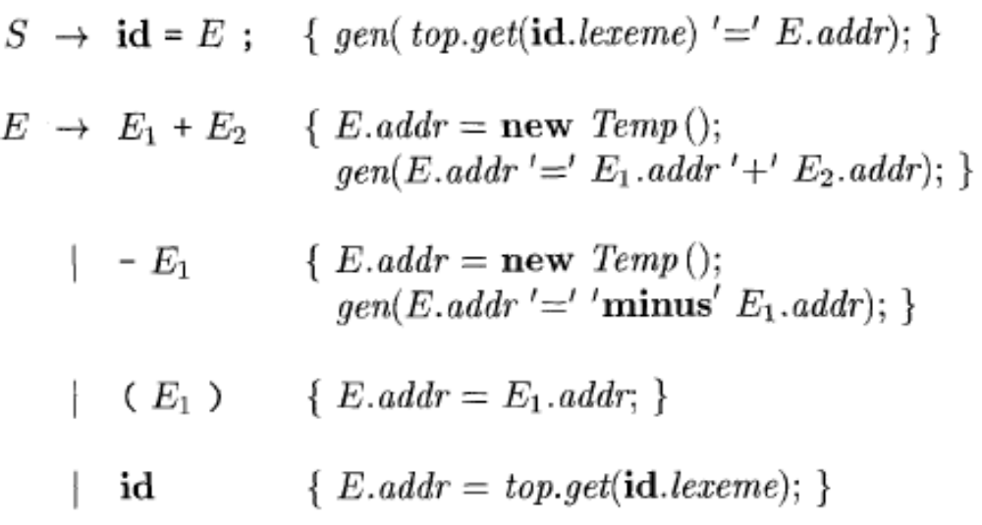
Incremental Translation
Code attribute not used & single sequence of instructions is created by successive calls to gen .

Slide 22
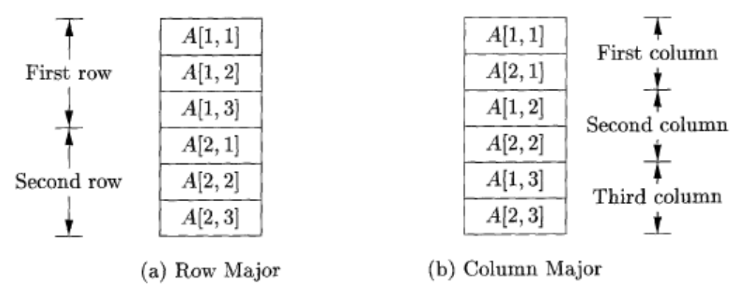
Addressing Array Elements
Layouts for a two-dimensional array:
If the width of each array element is w then the ith element of array A begins in the location base +i*w, where base is the relative address of the storage for A ie A[0]. This is row major method (C/Java).

Slide 23
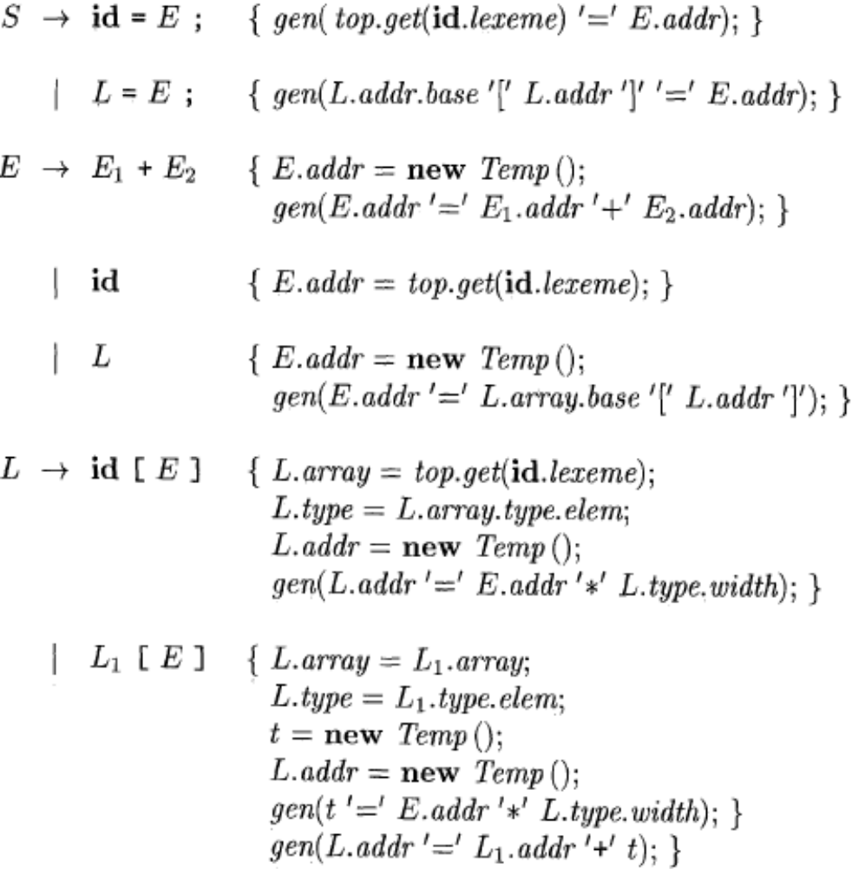
SDT: Semantic actions for array reference
Address for k dimension array :
base + i1*w1 +i2*w2+…+ik*wk
Lowest numbered array element is 0.

Slide 24
Translation of array references described
Nonterminal L has 3 synthesized attributes:
  L.addr denotes a temporary used for computing the offset for the array reference by summing the terms ij*wj
  L.array is a pointer to the symbol table entry for the array name
  L.type is the type of the subarray generated by L
S->id=E; represents an assignment to nonarray variable. S->L=E; generates indexed copy instruction to assign the value denoted by expression E to the location denoted by array ref.L
E->L generates code to copy the value location L to new temporary .

Slide 25
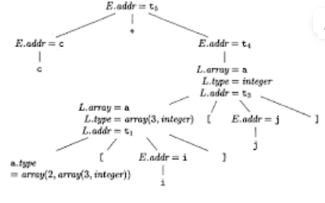
Translation of Array reference expressions: ex. c+a[i][j] (2x3 array)
c, i, j : integers
Type of a is array(2,array(3,integer) with width=24
Type of a[i] is array(3,integer) of width =12
Type of a[i][j] is integer
3 address code
  t1= i *12
  t2= j*4
  t3=t1+t2
  t4=a[t3]
  t5=c+t4

Slide 26
Control Flow
Translation of if else and while statements involve translation of Boolean expressions.
Boolean expressions are often used to:
Alter the flow of control: if (E ) S
Compute logical values
Grammar:
B-> B||B | B&&B | !B | (B) | E rel E | true | false
rel.op : <, <=, =, !=, >, >=

Slide 27
Translation of Boolean Expressions
Boolean expressions are composed of Boolean operators (&&, ||, !) applied to Boolean variables, relational expressions, and other Boolean expressions.
Short-circuit evaluation: &&, || and ! translate into jumps. Some languages, such as C and Java, do not require an entire Boolean expression to be evaluated. But with expressions with side effects (function changing global variable) unexpected answer is given.
  Given x && y, if x is false, then we can conclude the entire expression is false without evaluating y.
  Given x || y, if x is true, then we can conclude the entire expression is true without evaluating y.
Numerical encoding
  In C, the numerical value 0 represents false; a nonzero value represents true.
Positional encoding
  The value of a Boolean expression can be represented by a position in three address code, and the Boolean operators can be translated into jumps.

Slide 28
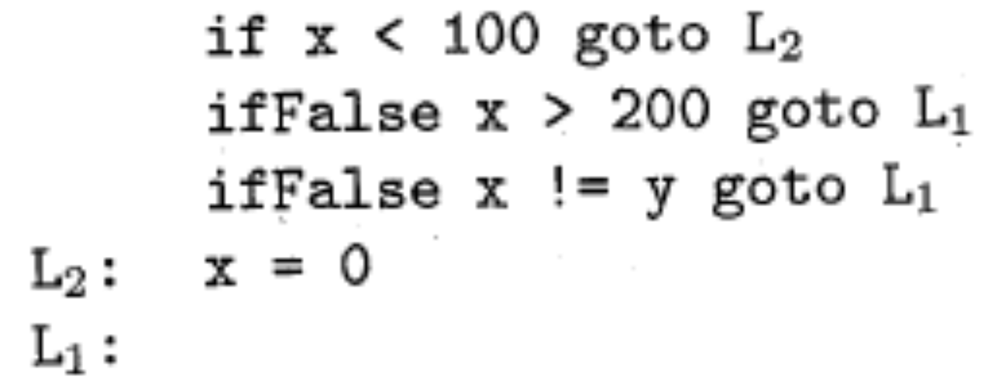
Short-Circuit Code (jumping code)
Statement:
Translation:
True if control reaches label L2
False if control goes to L1 skipping L2 and x=0.

Slide 29
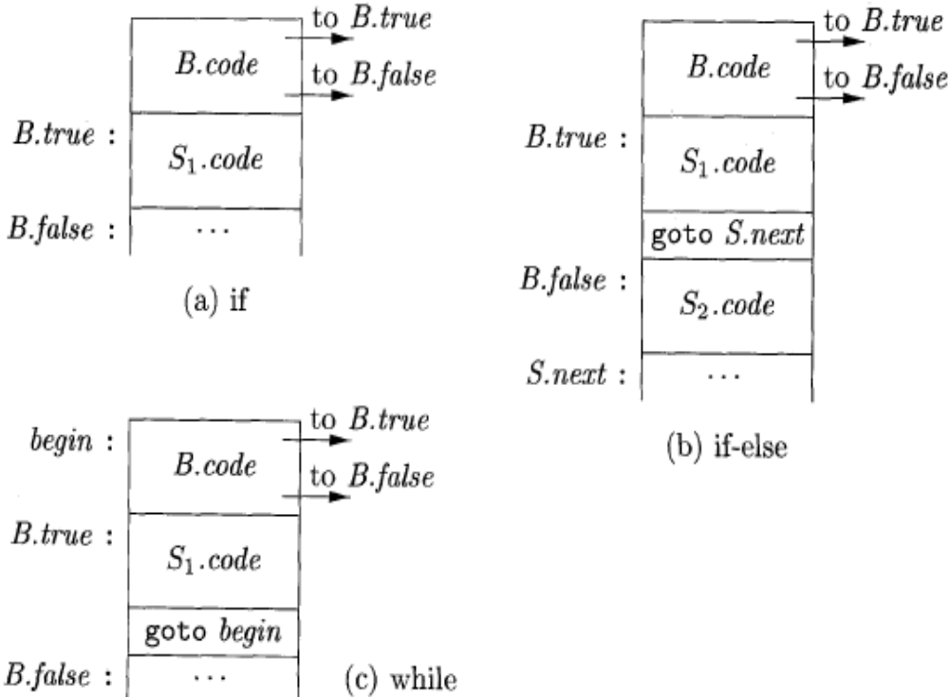
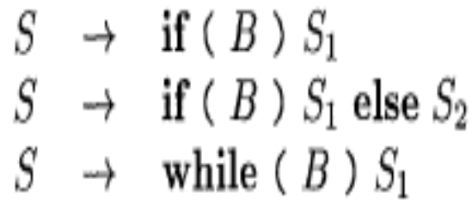
Flow-of-Control Statements

Slide 30
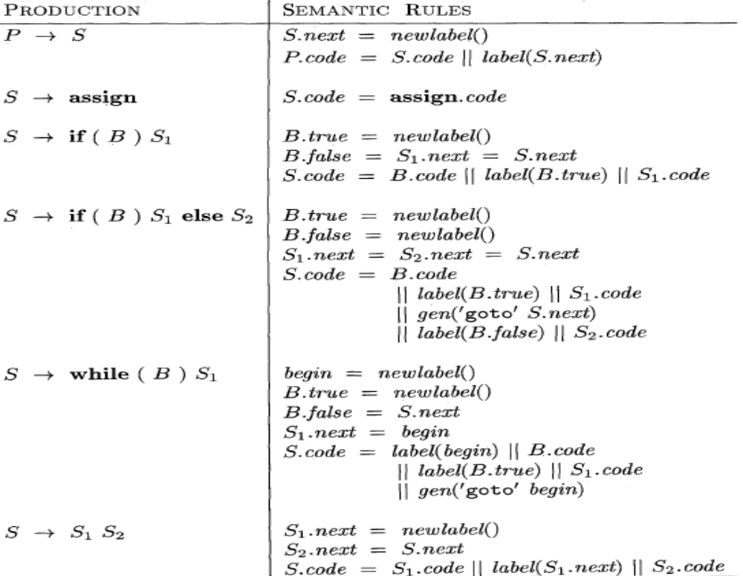
Syntax-directed definition for while & other control flow

Slide 31
Flow of control statements: SDD
We assume that newlabel() creates a new label each time it is called, and that label(L) attaches label L to the next three-address instruction to be generated
P->S represents program generating a statement. The semantic rules associated with this production initialize inherited attribute S.next to a new label. P.code consists of S.code followed by the new label S.next. Token assign in S->assign is a placeholder for assignment statements, in which S.code is assign.code
S->if (B) S1 : new label B.true is created and attached to statement S1; set B.false to S.next
S->if (B) S1 else S2: Jumps to first instruction S1 out of loop for True, and to S2 if false. Both S1.next and S2.next goto S.next.

Slide 32
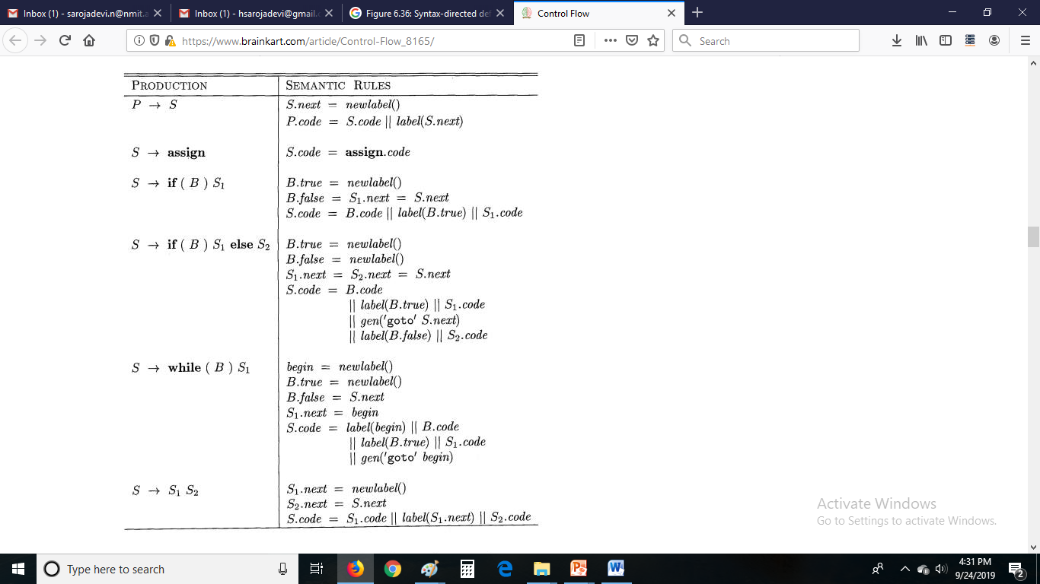


Slide 33
Flow of control statements (contd..)
S->while (B) S1 : a local variable begin holds new label for 1st instruction of while statement. It is variable & not attribute as it is local to this production. After the code for S1, goto begin occurs with S1.next=begin. Exit from loop happens with B.false=S.next
S->S1S2 is a code S1 followed by code S2. New label is given to S1.next, which indicates the beginning of S2 . Instruction after the code for S2 is also instruction after the code for S.

Slide 34
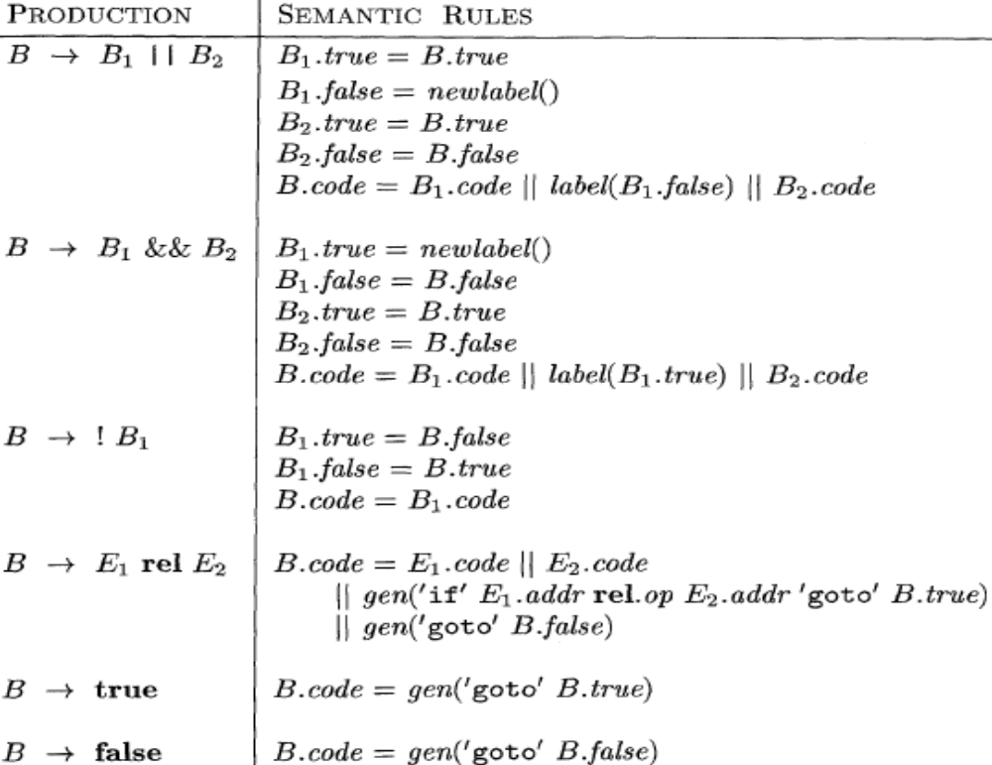
Generating three-address code for Booleans

Slide 35
Translation of Booleans
Suppose B is of the form B1 || B2. If B1 is true, then we immediately know that B itself is true, so B1.true is the same as B.true. If B1 is false, then B2 must be evaluated, so we make B1.false be the label of the first instruction in the code for B2. The true and false exits of B2 are the same as the true and false exits of B, respectively.
Translation of B1&&B2 is similar.
Interchange the true & false exits of B1 and emit B1.code
The fourth production B ->E1 rel E2, is translated directly into a comparison three-address instruction with jumps to the appropriate places. For instance, B of the form a < b translates into:
if a < b goto B.true
goto B.false
The Boolean constants true & false translate to jumps to B.true and B.false respectively.

Slide 36
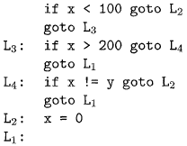
Translation of a simple if-statement
Precedence is from left to right, so OR is done first though it is of lower precedence.
Redundant goto can be avoided using ifFalse instruction that gets the default fall through path as below.

Slide 37
Backpatching
Previous codes for Boolean expressions insert symbolic labels as inherited attributes for jumps
It therefore needs a separate pass to bind them to appropriate addresses
We can use a technique named backpatching to avoid this
Lists of jumps are passed as synthesised attributes. Each jump generated has no target. These are kept in list. The labels can be filled when proper label value can be determined.
We assume we save instructions into an array and labels will be indices in the array
For nonterminal B we use two attributes B.truelist and B.falselist together with following functions:
  makelist(i): create a new list containing only i, an index into the array of instructions
  Merge(p1,p2): concatenates the lists pointed by p1 and p2 and returns a pointer to the concatenated list
  Backpatch(p,i): inserts i as the target label for each of the instruction on the list pointed to by p

Slide 38
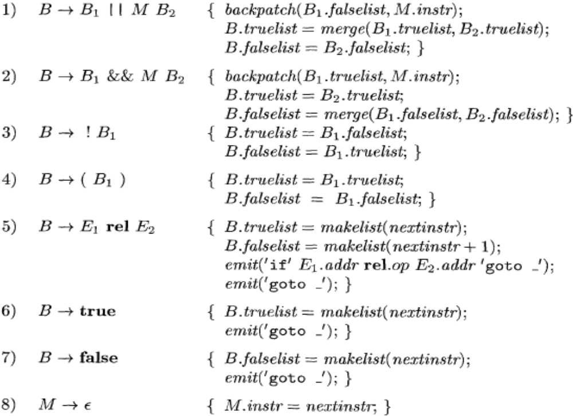
Backpatching for Boolean Expressions: translation scheme
M: marker nonterminal

Slide 39
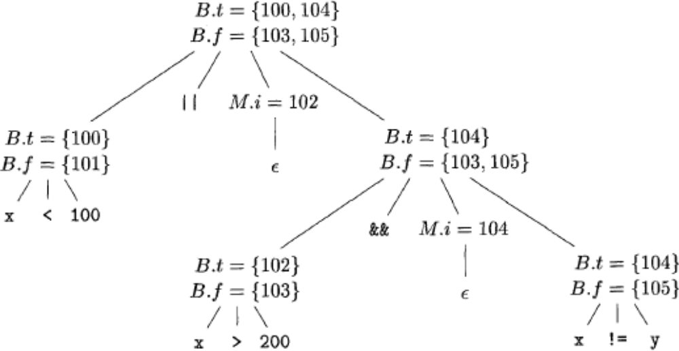
Backpatching for Boolean Expressions
Annotated parse tree for x < 100 || x > 200 && x ! = y
Start instruction at 100. marker nonterminal B->B1||MB2 records nextinstr=102
100: if x<100 goto –
101: goto -
102: if x>200 goto –
103: goto -
B1->B1&&MB2
gets 104 with M

Slide 40
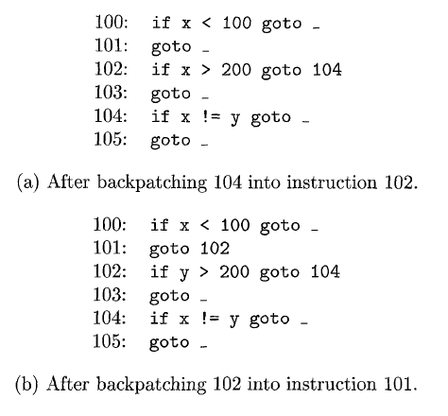

Backpatching example
The marker nonterminal M records the current value of nextinstr, which is now 104. Reducing x ! = y into B by production (5) generates
We now reduce by B -+ B1 && M B2. The corresponding semantic action calls backpatch(B1 .truelist, M.instr) to bind the true exit of Bl to the first instruction of B2. Since B1. truelist is (102) and M. instr is 104, this call s to backpatch fills in 104 in instruction 102. The six instructions generated so far are shown in Fig.(a).
The semantic action associated with the final reduction by B -+ B1 || M B2 calls backpatch({101},102) which leaves the instructions as in Fig. (b).
The entire expression is true if and only if the gotos of instructions 100 or 104 are reached, and is false if and only if the gotos of instructions 103 or 105 are reached. These instructions will have their targets filled in later in the compilation, when it is seen what must be done depending on the truth or falsehood of the expression

Slide 41
Flow of Control statements with backpatching
Grammar: S denotes statement & L statement list
A assignment statement & B Boolean expression
S -> if (B) S | if (B) S else S | while (B) S | {L} | A;
L -> LS | S
A is assignment statement.
In S->while M1 (B) M2 S1, the marker nonterminals M1 & M2 record the instruction no.s of the beginning (for label, begin) of the code for B and the beginning of the code for S1 (for label B.true)

Slide 42
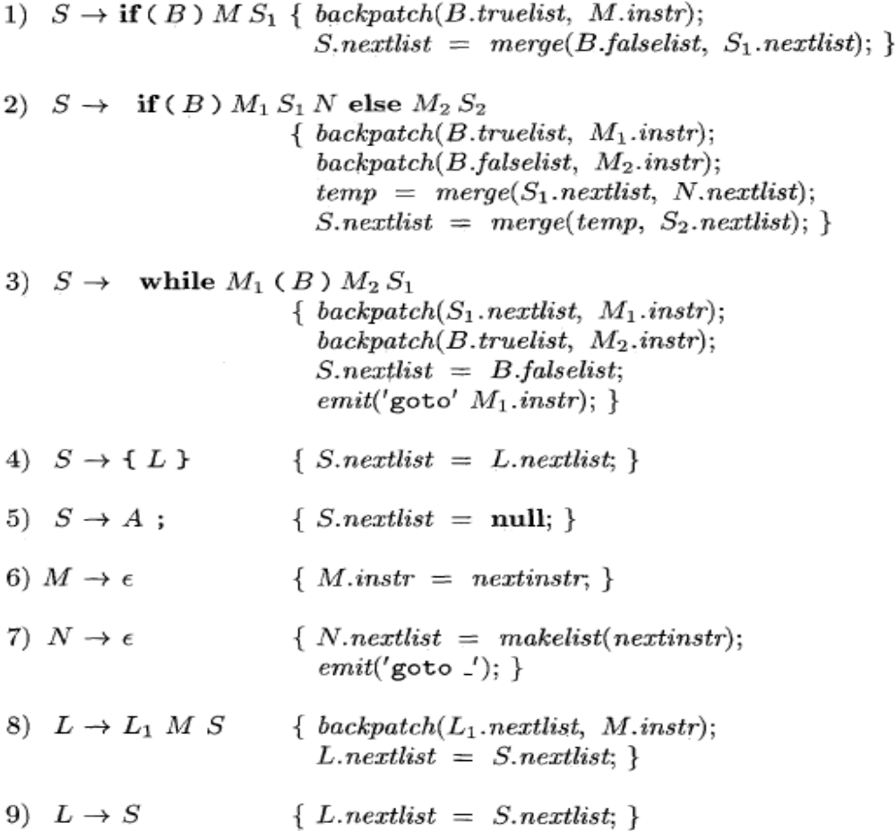
Flow-of-Control Statements with backpatching
In: if (B) S1 else S2, we need a jump over the code for S2 at the end of S1.
N is a marker nonterminal here to generate the jump after S1; N->ϵ
In L->L1MS instruction after the code for L1 is backpatched to the start of S.
(here A: assign)

Slide 43
Translation of switch statements: multiway branch
Code must be generated to translate switch ( E ) {…} to:
  Evaluate expression E
  Find the value Vj in the list of cases equal to the E value . Default value matches the expression if no explicit value mentioned under case match.
  Run the statement Sj associated with the value found.
  On getting keyword switch two new labels test & next, and new temporary t are generated.
  As we parse the expression E we generate code to evaluate E into t. Next jump is generated as ‘goto test’
  For each case keyword a new label L is created and put into symbol table. We process each “case Vi : Si” by emitting the label Li attached to the code for Si as “case t Vi Li” followed by the jump “goto next”.

Slide 44
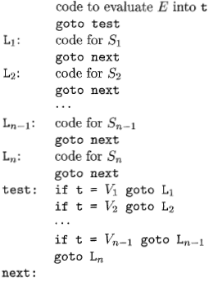
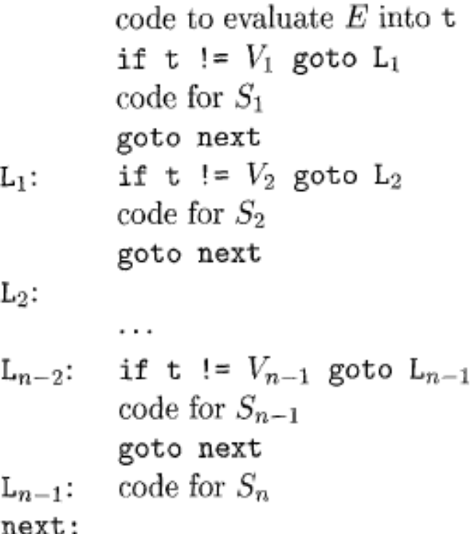
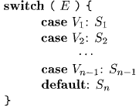
Translation of a switch-statement
Translation 1 Translation 2
(convenient) (Straight forward)

Slide 45
Switch statement (contd..)
Translation 1 has tests appearing in the end so that a simple code generator can recognize multiway branch and generate efficient code.
Translation 2 has branching statements in the beginning. Compiler has to do extensive analysis to find the most efficient implementation.

Slide 46
Intermediate code for procedures/ function
Consider n = f(a[i]) , where a is array of integers and f is a function from integers returning integer. (Function is a procedure that returns a value)
Translation into three address code:
t1 = i*4 // compute index for array a[i] , width=4
t2 = a [t1] // compute the value of a[i] into temp t2
param t2 // makes t2 a parameter for function f
t3 = call f, 1 // gets value returned by f to t3
n = t3 // returned value from f is assigned to n.

Slide 47
Break, Continue and Goto
Unfilled jumps are used for goto L in code C.
Java has disciplined jumps called break that sends control out of an enclosing construct, and continue statements, which trigger the next iteration of an enclosing loop. Example of simple break and continue statements:
  1) for ( ; ; readch ( ) {
  2) if( peek == ' ' || peek == ' \ t ' ) continue; //jump to 1.
  3) else if ( peek == ' \ n ' ) line = line + 1;
  4) else break;
  5) }
  Break and continue use jump / goto statements for implementation. If S is the enclosing construct then a break statement is a jump to the first instruction after the code for S. Code for break can be generated with, 1) keeping track of the enclosing statement S, 2) generating an unfilled jump for the break statement, 3) putting the unfilled jump into S.nextlist
  In two pass front end we can keep track of S by using the symbol table to map a special identifier break to the node for the enclosing statement S. Alternatively pointer to S.nextlist can be put in the symbol table.

Slide 48
Readings
Chapter 6 of the book

